Slide 1
Digital Design & Computer Arch.
Lecture 5: Combinational Logic II
Prof. Onur Mutlu
ETH Zürich
Spring 2020
5 March 2020

Slide 2
Assignment: Required Lecture Video
Why study computer architecture?
Why is it important?
Future Computing Architectures
Required Assignment
  Watch Prof. Mutlu’s inaugural lecture at ETH and understand it
  https://www.youtube.com/watch?v=kgiZlSOcGFM
Optional Assignment – for 1% extra credit
  Write a 1-page summary of the lecture and email us
    What are your key takeaways?
    What did you learn?
    What did you like or dislike?
    Submit your summary to Moodle – Deadline: April 1

Slide 3
Assignment: Required Readings
Last+This week
  Combinational Logic
    P&P Chapter 3 until 3.3 + H&H Chapter 2
This+Next week
  Hardware Description Languages and Verilog
    H&H Chapter 4 until 4.3 and 4.5
  Sequential Logic
    P&P Chapter 3.4 until end + H&H Chapter 3 in full
By the end of next week, make sure you are done with
  P&P Chapters 1-3 + H&H Chapters 1-4

Slide 4
Combinational Logic Circuits and Design

Slide 5
What We Will Learn in This Lecture
Building blocks of modern computers
  Transistors
  Logic gates
Combinational circuits
Boolean algebra
How to use Boolean algebra to represent combinational circuits
Minimizing logic circuits

Slide 6
Recall: Transistors and Logic Gates
Now, we know how a MOS transistor works
How do we build logic out of MOS transistors?
We construct basic logic structures out of individual MOS transistors
These logical units are named logic gates
  They implement simple Boolean functions
Problem
Algorithm
Program/Language
Runtime System
(VM, OS, MM)
ISA (Architecture)
Microarchitecture
Logic
Devices
Electrons

Slide 7
Recall: CMOS NOT, NAND, AND Gates

Slide 8
Recall: General CMOS Gate Structure
The general form used to construct any inverting logic gate, such as: NOT, NAND, or NOR
  The networks may consist of transistors in series or in parallel
  When transistors are in parallel, the network is ON if one of the transistors is ON
  When transistors are in series, the network is ON only if all transistors are ON
pMOS transistors are used for pull-up
nMOS transistors are used for pull-down
Notes:
N-type transistors pass 0’s well, but 1’s poorly
P-type transistors pass 1’s well, but 0’s poorly
That is why they are connected to the 3V and GND the way they are connected.
N-type’s source is connected to 0
P-type’s source is connected to 3V

Slide 9
Recall: Digging Deeper: Power Consumption
Dynamic Power Consumption
  C * V² * f
    C = capacitance of the circuit (wires and gates)
    V = supply voltage
    f = charging frequency of the capacitor
Static Power consumption
  V * I_{leakage}
    supply voltage * leakage current
Energy Consumption
  Power * Time
See more in H&H Chapter 1.8

Slide 10
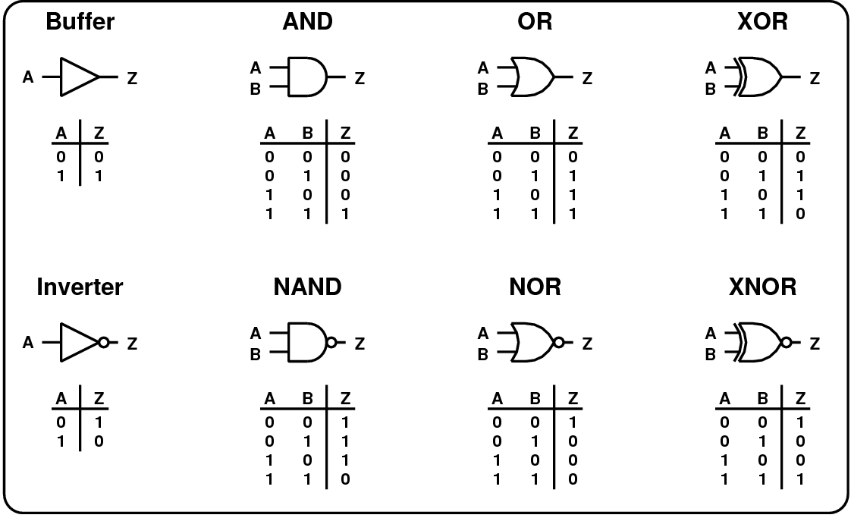
Recall: Common Logic Gates

Slide 11
Boolean Equations

Slide 12
Recall: Functional Specification
Functional specification of outputs in terms of inputs
What do we mean by “function”?
  Unique mapping from input values to output values
  The same input values produce the same output value every time
  No memory (does not depend on the history of input values)
Example (full 1-bit adder – more later):
S = F(A, B, C_{in})
C_{out} = G(A, B, C_{in})

Slide 13



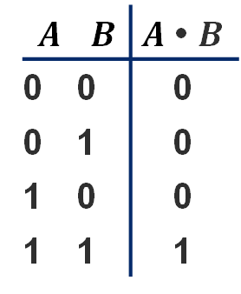
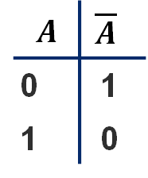

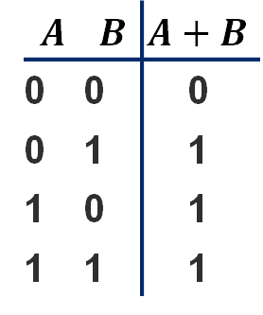
Recall: Boolean NOT / AND / OR
$$A$$ | $$\overline{A}$$
0 | 1
1 | 0
$\overline{A}$ (reads “not A”) is 1 iff A is 0
A
$$\overline{A}$$
$$A$$ | $$B$$ | $A$ • $B$
0 | 0 | 0
0 | 1 | 0
1 | 0 | 0
1 | 1 | 1
A • B (reads “A and B”) is 1 iff A and B are both 1
A
A • B
B
$$A$$ | $$B$$ | $A+B$
0 | 0 | 0
0 | 1 | 1
1 | 0 | 1
1 | 1 | 1
A + B (reads “A or B”) is 1 iff either A or B is 1
A
A + B
B

Slide 14
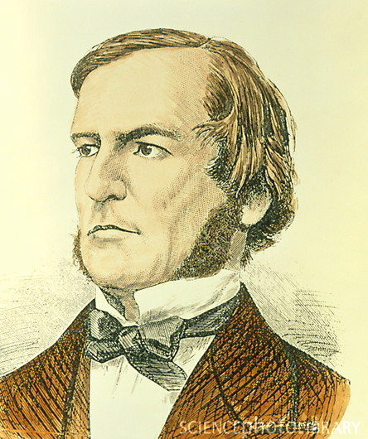
Recall: Boolean Algebra: Big Picture
An algebra on 1’s and 0’s
  with AND, OR, NOT operations
What you start with
  Axioms: basic things about objects and operations
  you just assume to be true at the start
What you derive first
  Laws and theorems: allow you to manipulate Boolean expressions
  …also allow us to do some simplification on Boolean expressions
What you derive later
  More “sophisticated” properties useful for manipulating digital designs represented in the form of Boolean equations
George Boole, “The Mathematical Analysis of Logic,” 1847.

Slide 15
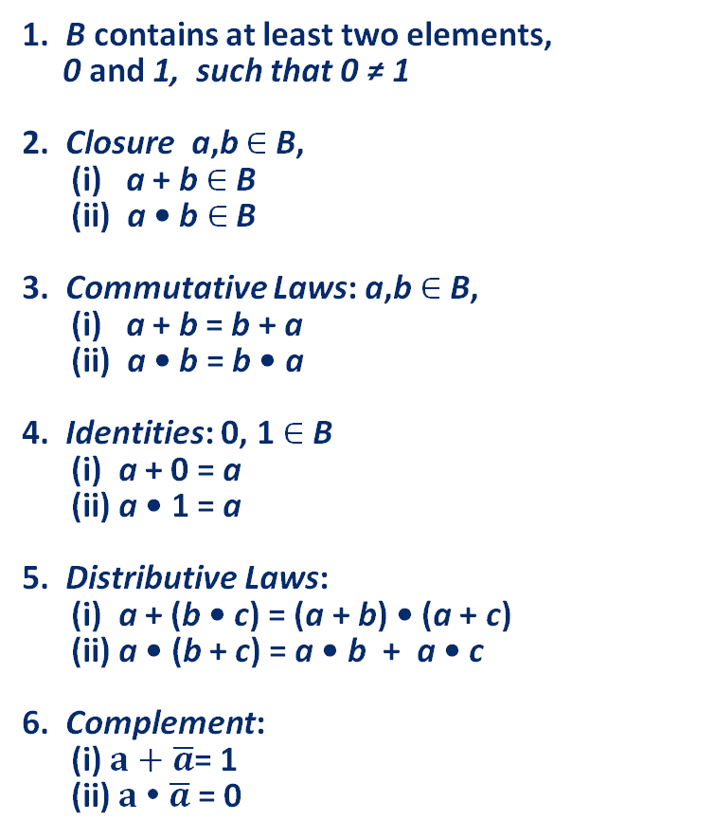
Recall: Boolean Algebra: Axioms
Formal version
English version
1. B contains at least two elements,
0 and 1, such that 0 ≠ 1
2. Closure a,b $∈$ B,
(i) a + b $∈$ B
(ii) a • b $∈$ B
3. Commutative Laws: a,b $∈$ B,
(i) a + b = b + a
(ii) a • b = b • a
4. Identities: 0, 1 $∈$ B
(i) a + 0 = a
(ii) a • 1 = a
5. Distributive Laws:
(i) a + (b • c) = (a + b) • (a + c)
(ii) a • (b + c) = a • b + a • c
6. Complement:
(i) $a+\overline{a}$= 1
(ii) $a \text{•} \overline{a}$= 0
Math formality...
Result of AND, OR stays
in set you start with
For primitive AND, OR of
2 inputs, order doesn’t matter
There are identity elements
for AND, OR, that give you back
what you started with
• distributes over +, just like algebra
…but + distributes over •, also (!!)
There is a complement element;
AND/ORing with it gives the identity elm.

Slide 16
Recall: Boolean Algebra: Duality
Observation
  All the axioms come in “dual” form
  Anything true for an expression also true for its dual
  So any derivation you could make that is true, can be flipped into dual form, and it stays true
Duality — More formally
  A dual of a Boolean expression is derived by replacing
    Every AND operation with... an OR operation
    Every OR operation with... an AND
    Every constant 1 with... a constant 0
    Every constant 0 with... a constant 1
    But don’t change any of the literals or play with the complements!
Example
a • (b + c) = (a • b) + (a • c)
➙ a + (b • c) = (a + b) • (a + c)

Slide 17



Recall: Boolean Algebra: Useful Laws
Dual
Operations with 0 and 1:
Idempotent Law:
Involution Law:
Laws of Complementarity:
Commutative Law:
AND, OR with identities
gives you back the original
variable or the identity
AND, OR with self = self
double complement =
no complement
AND, OR with complement
gives you an identity
Just an axiom…
1. X + 0 = X
2. X + 1 = 1
1D. X • 1 = X
2D. X • 0 = 0
3. X + X = X
3D. X • X = X
$$\overline{(\overline{X})}$$
4. = X
$$\overline{X}$$
$$\overline{X}$$
5. X + = 1
5D. X • = 0
6. X + Y = Y + X
6D. X • Y = Y • X

Slide 18




Recall: Useful Laws (continued)
Associative Laws:
7. (X + Y) + Z = X + (Y + Z)
= X + Y + Z
7D. (X • Y) • Z = X • (Y • Z)
= X • Y • Z
Parenthesis order
does not matter
Distributive Laws:
Simplification Theorems:
8. X • (Y+ Z) = (X • Y) + (X • Z)
8D. X + (Y• Z) = (X + Y) • (X + Z)
Axiom
$$\overline{Y}$$
$$\overline{Y}$$
9. X • Y + X • = X
10. X + X • Y = X
11. (X + ) • Y = X • Y
9D. (X + Y) • (X + ) = X
10D. X • (X + Y) = X
11D. (X • ) + Y = X + Y
Useful for
simplifying
expressions
$$\overline{Y}$$
$$\overline{Y}$$
Actually worth remembering — they show up a lot in real designs…

Slide 19


Boolean Algebra: Proving Things
Proving theorems via axioms of Boolean Algebra:
$$\overline{Y}$$
EX: Prove the theorem: X • Y + X • = X
X • ( Y + ) | = X | Distributive (5)
X • 1 | = X | Complement (6)
X | = X | Identity (4)
$$\overline{Y}$$
EX2: Prove the theorem: X + X • Y = X
X • 1 + X • Y | = X | Identity (4)
X • ( 1 + Y ) | = X | Distributive (5)
X • 1 | = X | Identity (2)
X | = X | Identity (4)

Slide 20



DeMorgan’s Law: Enabling Transformations
DeMorgan's Law:
12.
$$\overline{(X +Y+Z+…)}=\overline{X}.\overline{Y}.\overline{Z}. …$$
12D.
$$\overline{(X . Y.Z. …)}=\overline{X}+\overline{Y}+\overline{Z}+ …$$
Think of this as a transformation
  Let’s say we have:
  F = A + B + C
  Applying DeMorgan’s Law (12), gives us
$$F=\overline{\overline{(A+B+C)}}=\overline{(\overline{A}.\overline{B}.\overline{C})}$$
At least one of A, B, C is TRUE --> It is not the case that A, B, C are all false

Slide 21






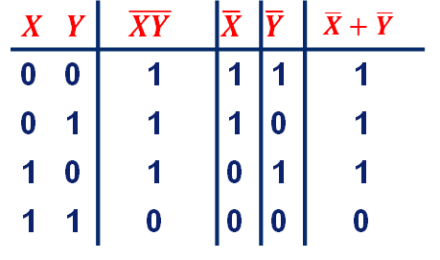







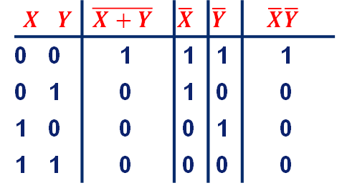


DeMorgan’s Law (Continued)
These are conversions between different types of logic functions
They can prove useful if you do not have every type of gate
$$A=\overline{(X+Y)}=\overline{X}\overline{Y}$$
$$X$$
$$A$$
$$Y$$
$$X$$ | $$Y$$ | $$\overline{X+Y}$$ | $$\overline{X}$$ | $$\overline{Y}$$ | $$\overline{X}\overline{Y}$$
0 | 0 | 1 | 1 | 1 | 1
0 | 1 | 0 | 1 | 0 | 0
1 | 0 | 0 | 0 | 1 | 0
1 | 1 | 0 | 0 | 0 | 0
NOR is equivalent to AND
with inputs complemented
$$X$$
$$A$$
$$Y$$
$$B=\overline{(XY)}=\overline{X}+\overline{Y}$$
$$X$$
$$B$$
$$X$$ | $$Y$$ | $$\overline{XY}$$ | $$\overline{X}$$ | $$\overline{Y}$$ | $$\overline{X}+\overline{Y}$$
0 | 0 | 1 | 1 | 1 | 1
0 | 1 | 1 | 1 | 0 | 1
1 | 0 | 1 | 0 | 1 | 1
1 | 1 | 0 | 0 | 0 | 0
$$Y$$
NAND is equivalent to OR
with inputs complemented
$$X$$
$$B$$
$$Y$$
Notes:
For some reason one type of gate might be much better than another one.
e.g., since pMOS transistors are slower, a NAND gate in CMOS is faster than a NOR gate in CMOS (all else being equal)

Slide 22
Using Boolean Equations to Represent a Logic Circuit

Slide 23
Sum of Products Form: Key Idea
Assume we have the truth table of a Boolean Function
How do we express the function in terms of the inputs in a standard manner?
Idea: Sum of Products form
Express the truth table as a two-level Boolean expression
  that contains all input variable combinations that result in a 1 output
  If ANY of the combinations of input variables that results in a 1 is TRUE, then the output is 1
  F = OR of all input variable combinations that result in a 1

Slide 24
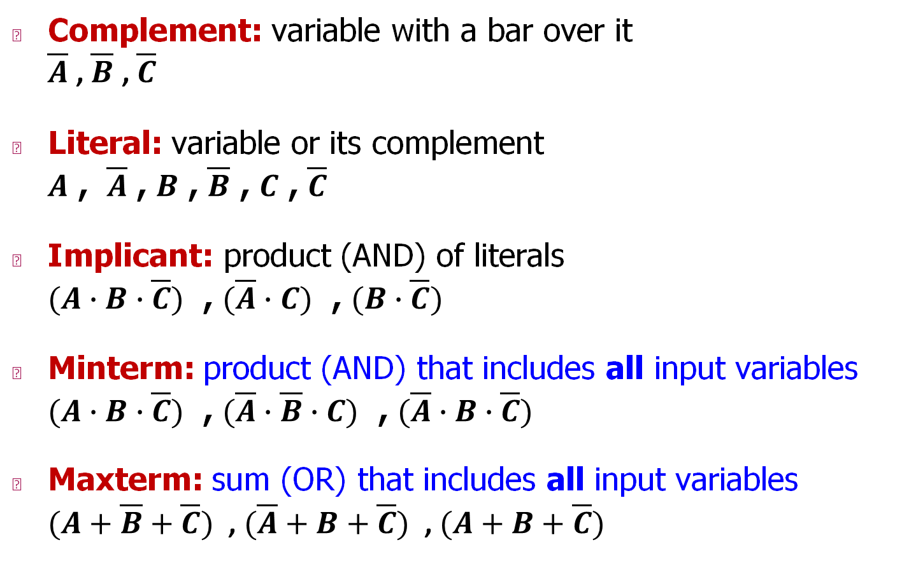
Some Definitions
Complement: variable with a bar over it
$\overline{A}$ , $\overline{B}$ , $\overline{C}$
Literal: variable or its complement
$A$ , $\overline{A}$ , $B$ , $\overline{B}$ , $C$ , $\overline{C}$
Implicant: product (AND) of literals
$(A∙B∙\overline{C})$ , $(\overline{A}∙C)$ , $(B∙\overline{C})$
Minterm: product (AND) that includes all input variables
$(A∙B∙\overline{C})$ , $(\overline{A}∙\overline{B}∙C)$ , $(\overline{A}∙B∙\overline{C})$
Maxterm: sum (OR) that includes all input variables
$(A+\overline{B}+\overline{C})$ , $(\overline{A}+B+\overline{C})$ , $(A+B+\overline{C})$

Slide 25
Two-Level Canonical (Standard) Forms
Truth table is the unique signature of a Boolean function …
  But, it is an expensive representation
A Boolean function can have many alternative Boolean expressions
  i.e., many alternative Boolean expressions (and gate realizations) may have the same truth table (and function)
  If they all say the same thing, why do we care?
    Different Boolean expressions lead to different gate realizations
Canonical form: standard form for a Boolean expression
  Provides a unique algebraic signature

Slide 26




Two-Level Canonical Forms
Sum of Products Form (SOP)
Also known as disjunctive normal form or minterm expansion
$$A$$
$$B$$
$$C$$
$$F$$
0 | 0 | 0 | 0
0 | 0 | 1 | 0
0 | 1 | 0 | 0
0 | 1 | 1 | 1
1 | 0 | 0 | 1
1 | 0 | 1 | 1
1 | 1 | 0 | 1
1 | 1 | 1 | 1
0 1 1
1 0 0
1 0 1
1 1 0
1 1 1
$$F=\overline{A}BC + A\overline{B}\overline{C} + A\overline{B}C + AB\overline{C} + ABC$$
  Each row in a truth table has a minterm
  A minterm is a product (AND) of literals
  Each minterm is TRUE for that row (and only that row)
All Boolean equations can be written in SOP form
Find all the input combinations (minterms) for which the output of the function is TRUE.

Slide 27

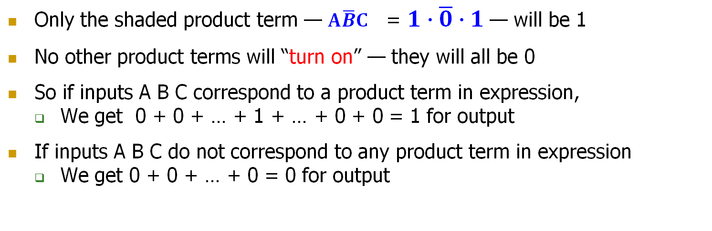
SOP Form — Why Does It Work?
This input
$$A$$
$$B$$
$$C$$
$$F$$
0 1 1
1 0 0
1 0 1
1 1 0
1 1 1
0 | 0 | 0 | 0
0 | 0 | 1 | 0
0 | 1 | 0 | 0
0 | 1 | 1 | 1
1 | 0 | 0 | 1
1 | 0 | 1 | 1
1 | 1 | 0 | 1
1 | 1 | 1 | 1
$$F=\overline{A}BC + A\overline{B}\overline{C} + A\overline{B}C + AB\overline{C} + ABC$$
Activates
this term
Only the shaded product term — $A\overline{B}C$ = $1∙\overline{0}∙1$— will be 1
No other product terms will “turn on” — they will all be 0
So if inputs A B C correspond to a product term in expression,
  We get 0 + 0 + … + 1 + … + 0 + 0 = 1 for output
If inputs A B C do not correspond to any product term in expression
  We get 0 + 0 + … + 0 = 0 for output

Slide 28
Aside: Notation for SOP
Standard “shorthand” notation
  If we agree on the order of the variables in the rows of truth table…
    then we can enumerate each row with the decimal number that corresponds to the binary number created by the input pattern
$$A$$
$$B$$
$$C$$
$$F$$
0 0 0 0
0 0 1 0
0 1 0 0
0 1 1 1
1 0 0 1
1 0 1 1
1 1 0 1
1 1 1 1
100 = decimal 4 so this is minterm #4, or m4
111 = decimal 7 so this is minterm #7, or m7
f =
We can write this as a sum of products
m3 + m4 + m5 + m6 + m7
= ∑m(3,4,5,6,7)
Or, we can use a summation notation

Slide 29















Canonical SOP Forms
$$A$$
$$B$$
$$C$$
minterms
0 0 0 = m0
0 0 1 = m1
0 1 0 = m2
0 1 1 = m3
1 0 0 = m4
1 0 1 = m5
1 1 0 = m6
1 1 1 = m7
F in canonical form:
$$\overline{A}\overline{B}\overline{C}$$
$$\overline{A}\overline{B}C$$
F(A,B,C) = ∑m(3,4,5,6,7)
$$\overline{A}B\overline{C}$$
= m3 + m4 + m5 + m6 + m7
$$\overline{A}BC$$
$$A\overline{B}\overline{C}$$
$$F=\overline{A}BC + A\overline{B}\overline{C}$$
$+ A\overline{B}C + AB\overline{C} + ABC$
$$A\overline{B}C$$
$$AB\overline{C}$$
$$ABC$$
canonical form ≠ minimal form
Shorthand Notation for
Minterms of 3 Variables
$$F=A\overline{B}\left(C+\overline{C}\right)+ \overline{A}BC+ AB(C+\overline{C})$$
$$=A\overline{B}+ \overline{A}BC+ AB$$
$$=A(\overline{B}+B)+ \overline{A}BC$$
$$=A+ \overline{A}BC$$
2-Level AND/OR
Realization
$$=A+ BC$$

Slide 30

From Logic to Gates
SOP (sum-of-products) leads to two-level logic
Example: $Y=\left(\overline{A}∙\overline{B}∙\overline{C}\right)+\left(A∙\overline{B}∙\overline{C}\right)+\left(A∙\overline{B}∙C\right)$

Slide 31

Alternative Canonical Form: POS
We can have another from of representation
DeMorgan of SOP of $\overline{F}$
A product of sums (POS)
products
$$F=(A+B+C)(A+B+\overline{C})(A+\overline{B}+C)$$
Each sum term represents one of the “zeros” of the function
sums
This input
0 0 0
0 0 1
0 1 0
$$A$$
$$B$$
$$C$$
$$F$$
$$F=\left(A+B+C\right) \left(A+B+\overline{C}\right) (A+\overline{B}+C)$$
0 | 0 | 0 | 0
0 | 0 | 1 | 0
0 | 1 | 0 | 0
0 | 1 | 1 | 1
1 | 0 | 0 | 1
1 | 0 | 1 | 1
1 | 1 | 0 | 1
1 | 1 | 1 | 1
Activates this term
For the given input, only the shaded sum term will equal 0
Anything ANDed with 0 is 0; Output F will be 0
$$A+\overline{B}+C=0+\overline{1}+0$$

Slide 32











Consider A=0, B=1, C=0
Input
$$A$$
$$B$$
$$C$$
$$F$$
0 1 0
$$F=(A+B+C)(A+B+\overline{C})(A+\overline{B}+C)$$
0 | 0 | 0 | 0
0 | 0 | 1 | 0
0 | 1 | 0 | 0
0 | 1 | 1 | 1
1 | 0 | 0 | 1
1 | 0 | 1 | 1
1 | 1 | 0 | 1
1 | 1 | 1 | 1
$$0 1 0$$
$$0 1 \overline{0}$$
$$0 \overline{1} 0$$
1
1
0
$$F=0$$
Only one of the products will be 0, anything ANDed with 0 is 0
Therefore, the output is F = 0

Slide 33





POS: How to Write It
$$A$$
$$B$$
$$C$$
$$F$$
$$F=(A+B+C)(A+B+\overline{C})(A+\overline{B}+C)$$
0 | 0 | 0 | 0
0 | 0 | 1 | 0
0 | 1 | 0 | 0
0 | 1 | 1 | 1
1 | 0 | 0 | 1
1 | 0 | 1 | 1
1 | 1 | 0 | 1
1 | 1 | 1 | 1
$$A$$
$$\overline{B}$$
$$C$$
$$A + \overline{B} + C$$
Maxterm form:
1. Find truth table rows where F is 0
2. 0 in input col ➙ true literal
3. 1 in input col ➙ complemented literal
4. OR the literals to get a Maxterm
5. AND together all the Maxterms
Or just remember, POS of $F$ is the same as the DeMorgan of SOP of $\overline{F}$ !!

Slide 34






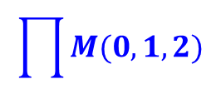




Canonical POS Forms
Product of Sums / Conjunctive Normal Form / Maxterm Expansion
$$F=(A+B+C)(A+B+\overline{C})(A+\overline{B}+C)$$
$$\prod{M(0,1,2)}$$
$$A$$
$$B$$
$$C$$
Maxterms
0 0 0 = M0
0 0 1 = M1
0 1 0 = M2
0 1 1 = M3
1 0 0 = M4
1 0 1 = M5
1 1 0 = M6
1 1 1 = M7
$$A+B+C$$
$$A+B+\overline{C}$$
$$A$$
$$B$$
$$C$$
$$F$$
$$A+\overline{B}+C$$
0 | 0 | 0 | 0
0 | 0 | 1 | 0
0 | 1 | 0 | 0
0 | 1 | 1 | 1
1 | 0 | 0 | 1
1 | 0 | 1 | 1
1 | 1 | 0 | 1
1 | 1 | 1 | 1
Note that you form the maxterms around the “zeros” of the function
This is not the complement of the function!
$$A+\overline{B}+\overline{C}$$
$$\overline{A}+B+C$$
$$\overline{A}+B+\overline{C}$$
$$\overline{A}+\overline{B}+C$$
$$\overline{A}+\overline{B}+\overline{C}$$
Maxterm shorthand notation
for a function of three variables

Slide 35

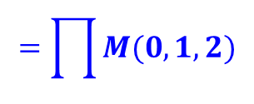
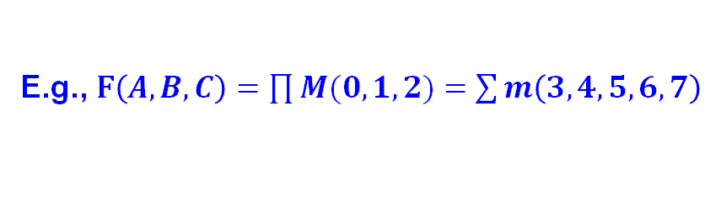
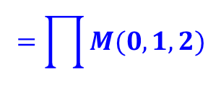
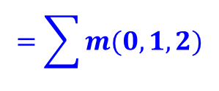
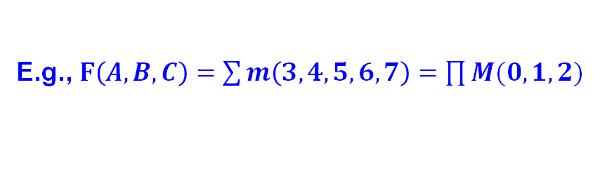

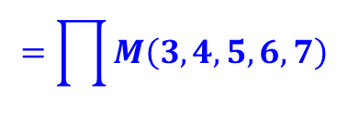

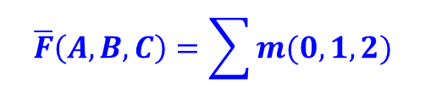

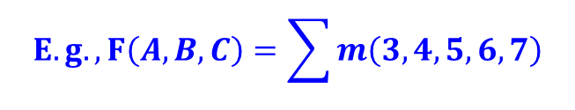



Useful Conversions
1.
Minterm to Maxterm conversion:
rewrite minterm shorthand using maxterm shorthand
replace minterm indices with the indices not already used
E.g., $F\left(A,B,C\right)=\sum{m\left(3,4,5,6,7\right)=\prod{M(0,1,2)}}$
2.
Maxterm to Minterm conversion:
rewrite maxterm shorthand using minterm shorthand
replace maxterm indices with the indices not already used
E.g., $F\left(A,B,C\right)=\prod{M(0,1,2)}=\sum{m\left(3,4,5,6,7\right)}$
3.
$$F$$
$$\overline{F}$$
Expansion of to expansion of :
$$E.g., F\left(A,B,C\right)=\sum{m\left(3,4,5,6,7\right)}$$
$$\overline{F}\left(A,B,C\right)=\sum{m(0,1,2)}$$
$$=\prod{M(0,1,2)}$$
$$=\prod{M\left(3,4,5,6,7\right)}$$
4.
$$F$$
$$\overline{F}$$
Minterm expansion of to Maxterm expansion of :
$$F$$
rewrite in Maxterm form, using the same indices as
$$E.g., F\left(A,B,C\right)=\sum{m\left(3,4,5,6,7\right)}$$
$\overline{F}\left(A,B,C\right)$ $=\prod{M\left(3,4,5,6,7\right)}$
$$=\prod{M(0,1,2)}$$
$$=\sum{m(0,1,2)}$$

Slide 36
Combinational Building Blocks used in Modern Computers

Slide 37
Combinational Building Blocks
Combinational logic is often grouped into larger building blocks to build more complex systems
Hides the unnecessary gate-level details to emphasize the function of the building block
We now look at:
  Decoder
  Multiplexer
  Full adder
  PLA (Programmable Logic Array)

Slide 38
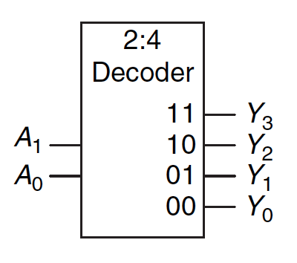
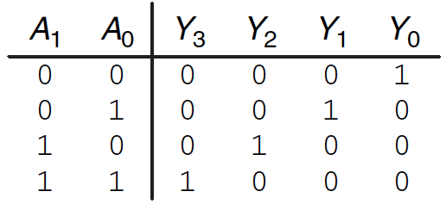
Decoder
“Input pattern detector”
n inputs and 2^{n} outputs
Exactly one of the outputs is 1 and all the rest are 0s
The one output that is logically 1 is the output corresponding to the input pattern that the logic circuit is expected to detect
Example: 2-to-4 decoder

Slide 39
Decoder (I)
n inputs and 2^{n} outputs
Exactly one of the outputs is 1 and all the rest are 0s
The one output that is logically 1 is the output corresponding to the input pattern that the logic circuit is expected to detect

Slide 40
Decoder (II)
The decoder is useful in determining how to interpret a bit pattern
  It could be the address of a row in DRAM, that the processor intends to read from
  It could be an instruction in the program and the processor has to decide what action to do! (based on instruction opcode)

Slide 41
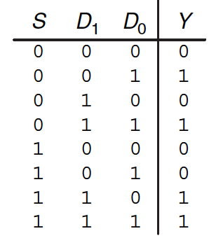
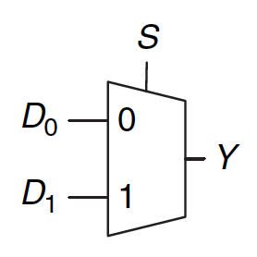
Multiplexer (MUX), or Selector
Selects one of the N inputs to connect it to the output
  based on the value of a log₂N-bit control input called select
Example: 2-to-1 MUX

Slide 42
Multiplexer (MUX), or Selector (II)
Selects one of the N inputs to connect it to the output
  based on the value of a log₂N-bit control input called select
Example: 2-to-1 MUX

Slide 43
Multiplexer (MUX), or Selector (III)
The output C is always connected to either the input A or the input B
  Output value depends on the value of the select line S
Your task: Draw the schematic for an 4-input (4:1) MUX
  Gate level: as a combination of basic AND, OR, NOT gates
  Module level: As a combination of 2-input (2:1) MUXes

Slide 44
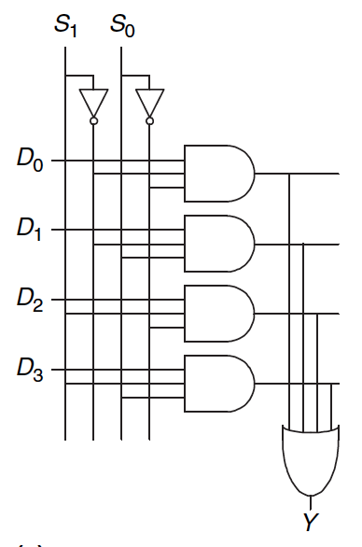
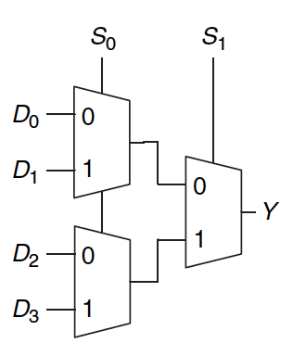
A 4-to-1 Multiplexer

Slide 45




Full Adder (I)
Binary addition
  Similar to decimal addition
  From right to left
  One column at a time
  One sum and one carry bit
Truth table of binary addition on one column of bits within two n-bit operands
$$a_{n−1}a_{n−2}…a_{1}a_{0}$$
$$b_{n−1}b_{n−2}…b_{1}b_{0}$$
$$C_{n} C_{n−1} … C_{1}$$
$$S_{n−1} … S_{1}S_{0}$$

Slide 46

Full Adder (II)
Binary addition
  N 1-bit additions
  SOP of 1-bit addition
$$a_{n−1}a_{n−2}…a_{1}a_{0}$$
$$b_{n−1}b_{n−2}…b_{1}b_{0}$$
Full Adder (1 bit)
Full Adder
$$C_{n} C_{n−1} … C_{1}$$
$$S_{n−1} … S_{1}S_{0}$$

Slide 47








4-Bit Adder from Full Adders
Creating a 4-bit adder out of 1-bit full adders
  To add two 4-bit binary numbers A and B
$$a_{3} a_{2} a_{1} a_{0}$$
$$1_{} 0_{} 1_{} 1_{}$$
+
+
$$b_{3} { b}_{2} b_{1} b_{0}$$
$$1_{} { 0}_{} 0_{} 1_{}$$
$$c_{4} c_{3} c_{2} c_{1}$$
$$1_{} 0_{} 1_{} 1_{}$$
$$s_{3} s_{2} s_{1} s_{0}$$
$$0_{} 1_{} 0_{} 0_{}$$

Slide 48
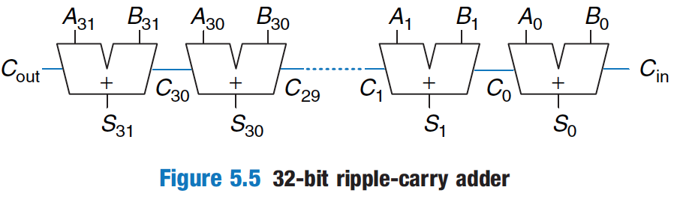
Adder Design: Ripple Carry Adder

Slide 49
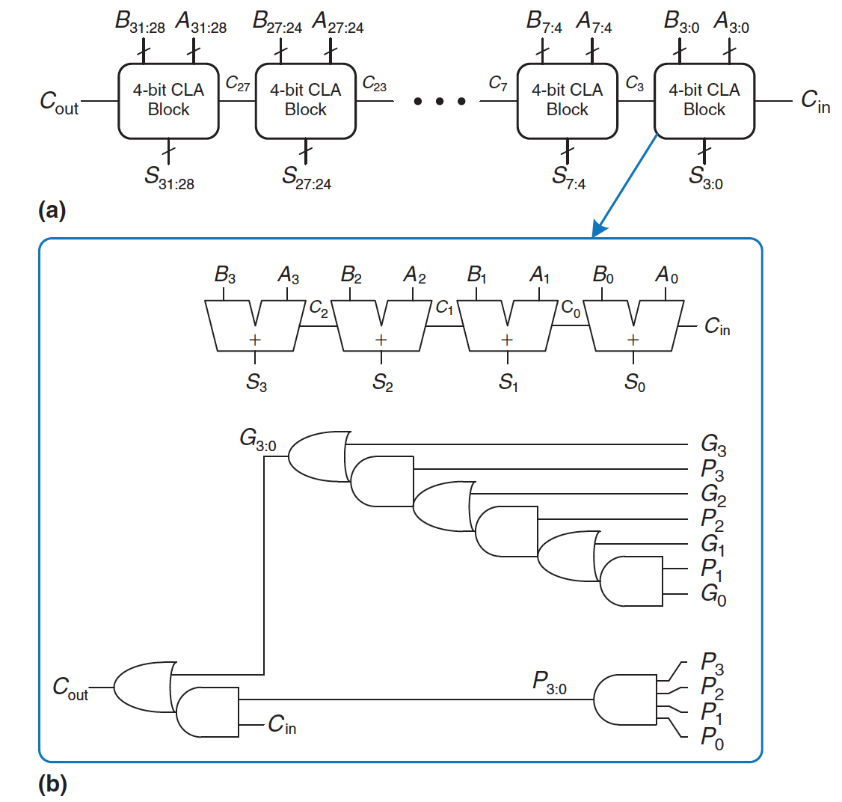
Adder Design: Carry Lookahead Adder

Slide 50
PLA: Recall: From Logic to Gates
SOP (sum-of-products) leads to two-level logic
Example: $Y=\left(\overline{A}∙\overline{B}∙\overline{C}\right)+\left(A∙\overline{B}∙\overline{C}\right)+\left(A∙\overline{B}∙C\right)$

Slide 51
The Programmable Logic Array (PLA)
The below logic structure is a very common building block for implementing any collection of logic functions one wishes to
An array of AND gates followed by an array of OR gates
How do we determine the number of AND gates?
  Remember SOP: the number of possible minterms
  For an n-input logic function, we need a PLA with 2^{n} n-input AND gates
How do we determine the number of OR gates? The number of output columns in the truth table

Slide 52
The Programmable Logic Array (PLA)
How do we implement a logic function?
  Connect the output of an AND gate to the input of an OR gate if the corresponding minterm is included in the SOP
  This is a simple programmable logic
Programming a PLA: we program the connections from AND gate outputs to OR gate inputs to implement a desired logic function
Have you seen any other type of programmable logic?
  Yes! An FPGA…
  An FPGA uses more advanced structures, as we saw in Lecture 3

Slide 53
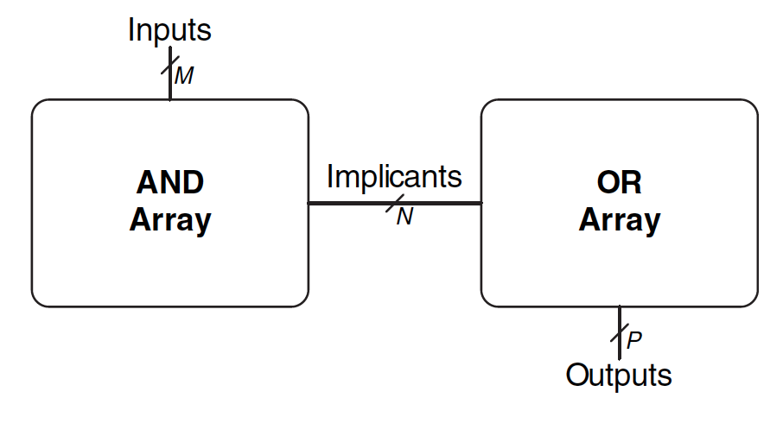
PLA Example (I)
Read H&H Chapter 5.6.1

Slide 54
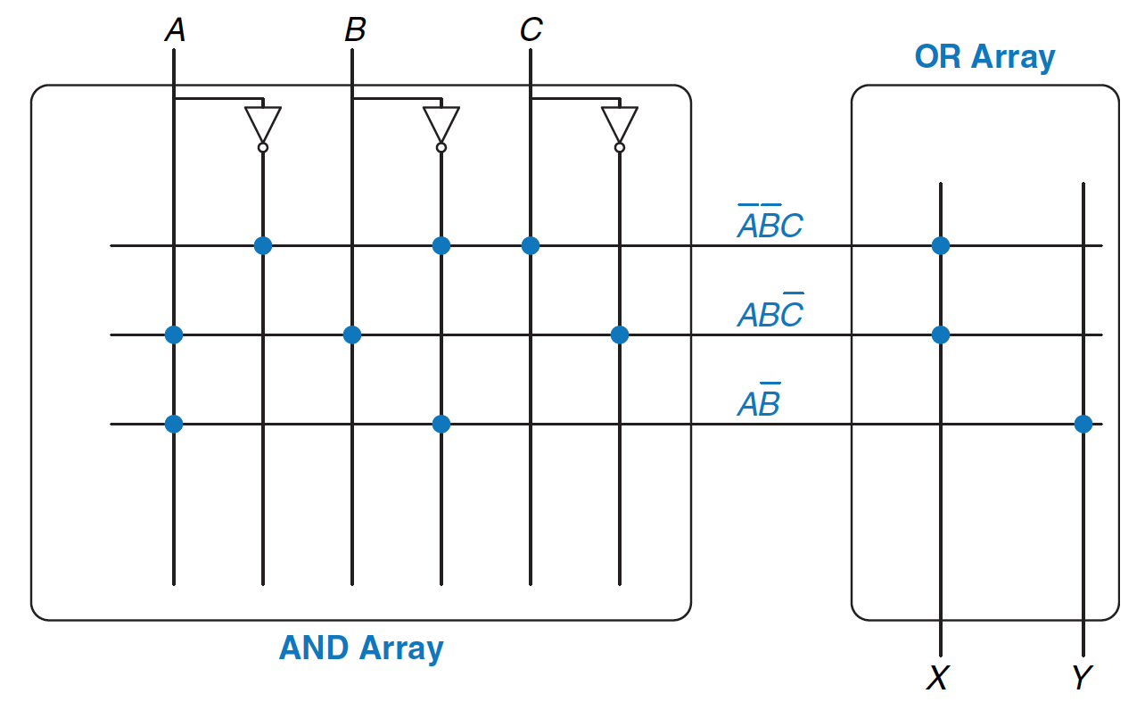
PLA Example Function (II)
Read H&H Chapter 5.6.1

Slide 55
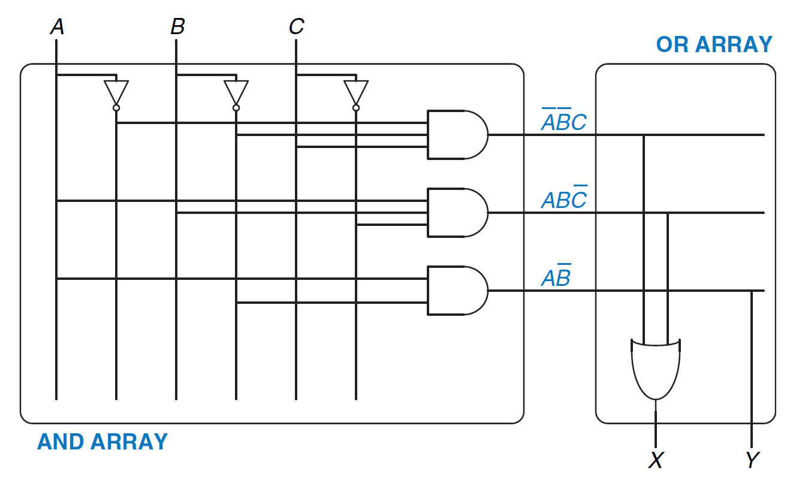
PLA Example Function (III)
Read H&H Chapter 5.6.1

Slide 56
Implementing a Full Adder Using a PLA
This input should not be
connected to any outputs
We do not need
this output
Truth table of a full adder

Slide 57
Logical (Functional) Completeness
Any logic function we wish to implement could be accomplished with a PLA
  PLA consists of only AND gates, OR gates, and inverters
  We just have to program connections based on SOP of the intended logic function
The set of gates {AND, OR, NOT} is logically complete because we can build a circuit to carry out the specification of any truth table we wish, without using any other kind of gate
NAND is also logically complete. So is NOR.
  Your task: Prove this.

Slide 58
More Combinational Building Blocks
H&H Chapter 2 in full
  Required Reading
  E.g., see Tri-state Buffer and Z values in Section 2.6
H&H Chapter 5
  Will be required reading soon.
You will benefit greatly by reading the “combinational” parts of Chapter 5 soon.
  Sections 5.1 and 5.2

Slide 59
Tri-State Buffer
A tri-state buffer enables gating of different signals onto a wire
Floating signal (Z): Signal that is not driven by any circuit
  Open circuit, floating wire

Slide 60
Example: Use of Tri-State Buffers
Imagine a wire connecting the CPU and memory
  At any time only the CPU or the memory can place a value on the wire, both not both
  You can have two tri-state buffers: one driven by CPU, the other memory; and ensure at most one is enabled at any time

Slide 61
Example Design with Tri-State Buffers
GateCPU
CPU
GateMem
Memory
Shared Bus

Slide 62
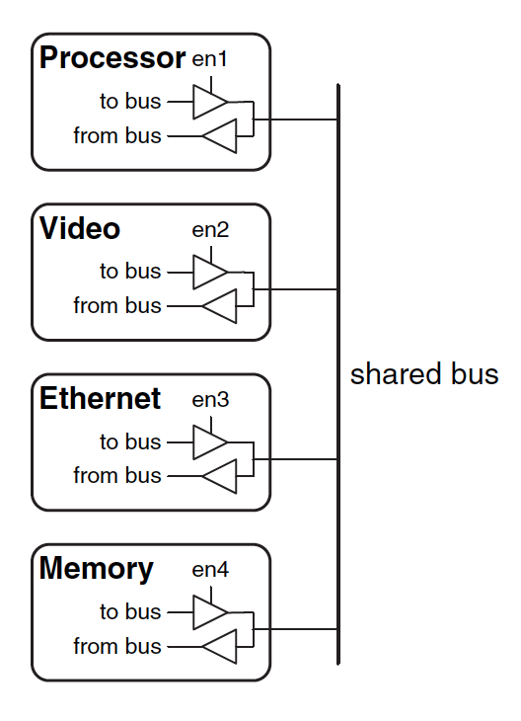
Another Example

Slide 63
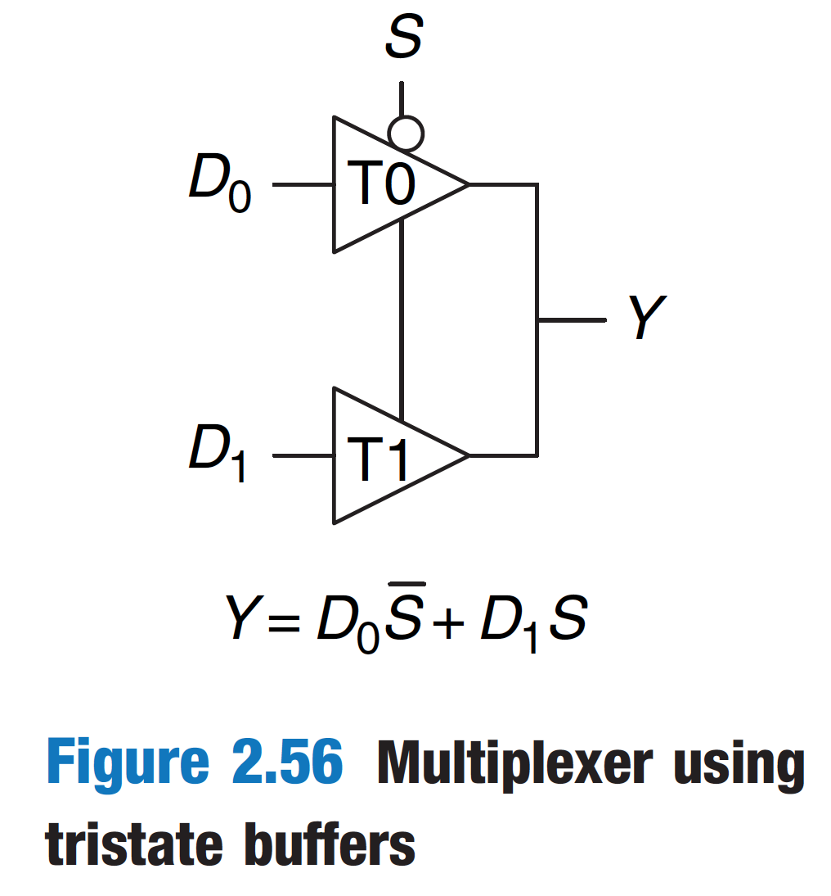
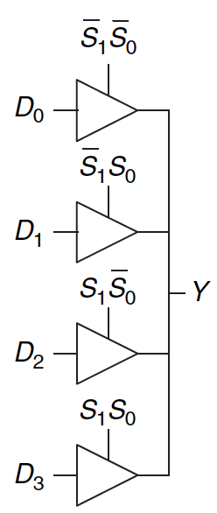
Multiplexer Using Tri-State Buffers

Slide 64
Digital Design & Computer Arch.
Lecture 5: Combinational Logic II
Prof. Onur Mutlu
ETH Zürich
Spring 2020
5 March 2020

Slide 65
We did not cover the remaining slides. They are for your preparation for the next lecture.

Slide 66
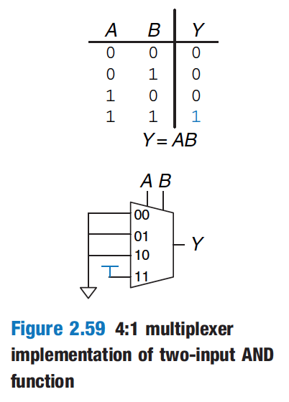
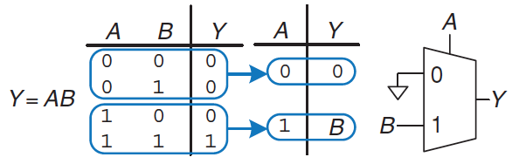
Aside: Logic Using Multiplexers
Multiplexers can be used as lookup tables to perform logic functions

Slide 67
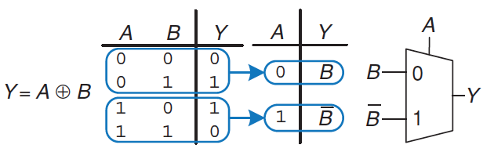
Aside: Logic Using Multiplexers (II)
Multiplexers can be used as lookup tables to perform logic functions

Slide 68
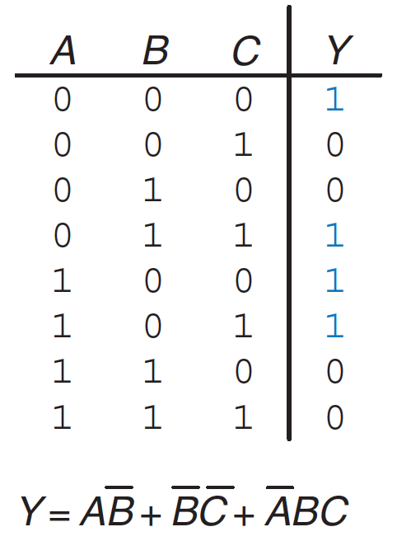
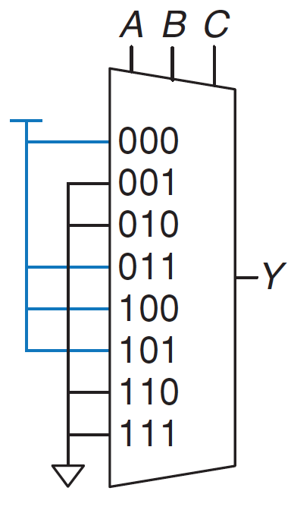
Aside: Logic Using Multiplexers (III)
Multiplexers can be used as lookup tables to perform logic functions

Slide 69
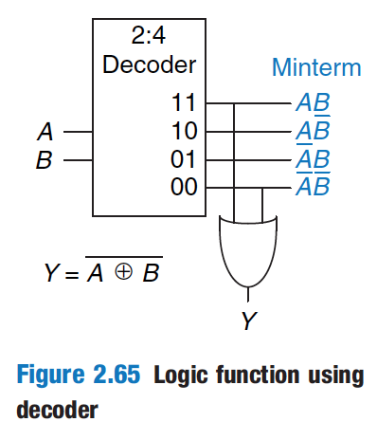
Aside: Logic Using Decoders (I)
Decoders can be combined with OR gates to build logic functions.
Read H&H Chapter 2.8

Slide 70
Logic Simplification:
Karnaugh Maps (K-Maps)

Slide 71
Recall: Full Adder in SOP Form Logic
Full Adder

Slide 72
Goal: Simplified Full Adder
How do we simplify Boolean logic?

Slide 73
Quick Recap on Logic Simplification
The original Boolean expression (i.e., logic circuit) may not be optimal
Can we reduce a given Boolean expression to an equivalent expression with fewer terms?
The goal of logic simplification:
  Reduce the number of gates/inputs
  Reduce implementation cost
F = ~A(A + B) + (B + AA)(A + ~B)
F = A + B
A basis for what the automated design tools are doing today

Slide 74
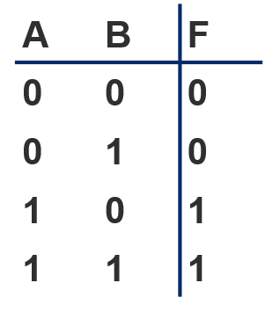
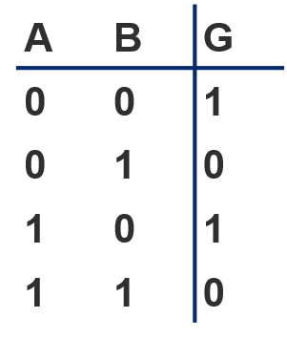




Logic Simplification
Systematic techniques for simplifications
  amenable to automation
$$F= A\overline{B}+AB$$
Key Tool: The Uniting Theorem —
$F=$
$$A\overline{B}+AB=A\left(\overline{B}+B\right)=A\left(1\right)=A$$
Essence of Simplification:
Find two element subsets of the ON-set where only one variable changes its value. This single varying variable can be eliminated!
B's value changes within the rows where F==1 (“ON set”)
A's value does NOT change within the ON-set rows
If an input (B) can change without changing the output, that input value is not needed
➙ B is eliminated, A remains
$G=$
$\overline{A}\overline{B}+A\overline{B}=\left(\overline{A}+A\right)\overline{B}=\overline{B}$
B's value stays the same within the ON-set rows
A's value changes within the ON-set rows
➙ A is eliminated, B remains

Slide 75
Complex Cases
One example
Problem
  Easy to see how to apply Uniting Theorem…
  Hard to know if you applied it in all the right places…
  …especially in a function of many more variables
Question
  Is there an easier way to find potential simplifications?
  i.e., potential applications of Uniting Theorem…?
Answer
  Need an intrinsically geometric representation for Boolean f( )
  Something we can draw, see…
$$Cout=\overline{A}BC+A\overline{B}C+AB\overline{C}+ABC$$

Slide 76






Karnaugh Map
Karnaugh Map (K-map) method
  K-map is an alternative method of representing the truth table that helps visualize adjacencies in up to 6 dimensions
  Physical adjacency ↔ Logical adjacency
 |  | 0 | 1
0 |  | 00 | 01
1 |  | 10 | 11
 |  | 00 | 01 | 11 | 10
0 |  | 000 | 001 | 011 | 010
1 |  | 100 | 101 | 111 | 110
 |  | 00 | 01 | 11 | 10
00 |  | 0000 | 0001 | 0011 | 0010
01 |  | 0100 | 0101 | 0111 | 0110
11 |  | 1100 | 1101 | 1111 | 1110
10 |  | 1000 | 1001 | 1011 | 1010
2-variable K-map
3-variable K-map
4-variable K-map
$$B$$
$$BC$$
$$CD$$
$$A$$
$$AB$$
$$A$$
Numbering Scheme: 00, 01, 11, 10 is called a
“Gray Code” — only a single bit (variable) changes
from one code word and the next code word

Slide 77

Karnaugh Map Methods
Adjacent
 |  | 00 | 01 | 11 | 10
0 |  | 000 | 001 | 011 | 010
1 |  | 100 | 101 | 111 | 110
$$BC$$
$$A$$
000
010
110
100
001
011
111
101
000
010
110
100
001
011
111
101
Adjacent
K-map adjacencies go “around the edges”
Wrap around from first to last column
Wrap around from top row to bottom row

Slide 78






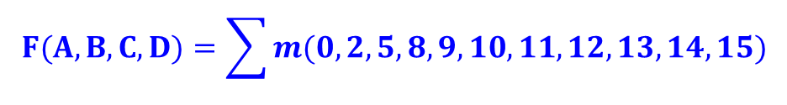
K-map Cover - 4 Input Variables
 |  | 00 | 01 | 11 | 10
00 |  | 1 | 0 | 0 | 1
01 |  | 0 | 1 | 0 | 0
11 |  | 1 | 1 | 1 | 1
10 |  | 1 | 1 | 1 | 1
$$F(A,B,C,D)=\sum{m(0,2,5,8,9,10,11,12,13,14,15)}$$
$$CD$$
$$AB$$
$$A+\overline{B}\overline{D}+B\overline{C}D$$
$$F=$$
$$A$$
$$A+\overline{B}\overline{D}$$
Strategy for “circling” rectangles on Kmap:
As big as possible
Biggest “oops!” that people forget:
Wrap-arounds

Slide 79
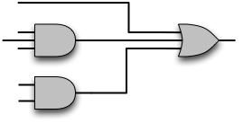





Example: As Logic Gates
What does this solution look like as gates?
$$B\overline{C}D+A+\overline{B}\overline{D}$$
$$A$$
$$\overline{C}$$
$$B$$
$$D$$
$$\overline{B}$$
$$\overline{D}$$

Slide 80
Logic Minimization Using K-Maps
Very simple guideline:
  Circle all the rectangular blocks of 1’s in the map, using the fewest possible number of circles
    Each circle should be as large as possible
  Read off the implicants that were circled
More formally:
  A Boolean equation is minimized when it is written as a sum of the fewest number of prime implicants
  Each circle on the K-map represents an implicant
  The largest possible circles are prime implicants

Slide 81
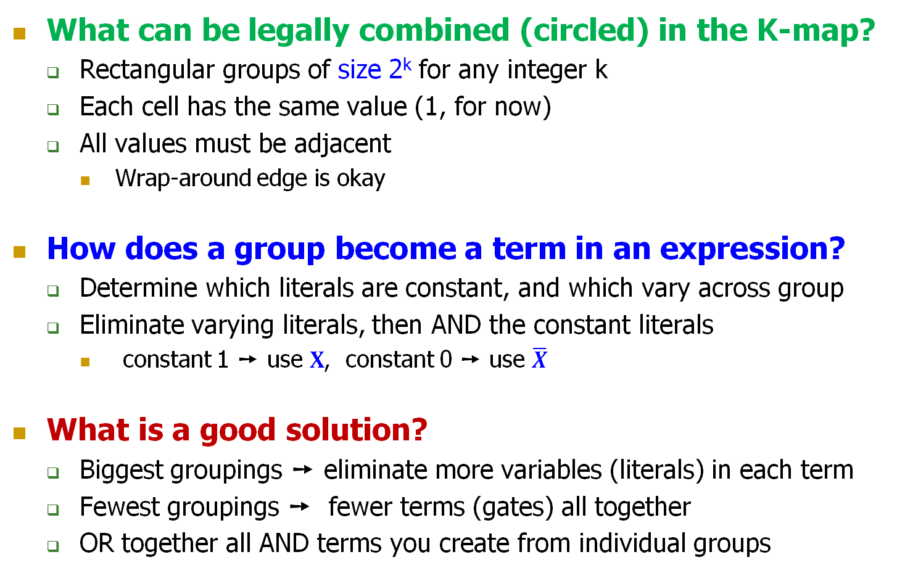
K-map Rules
What can be legally combined (circled) in the K-map?
  Rectangular groups of size 2^{k} for any integer k
  Each cell has the same value (1, for now)
  All values must be adjacent
    Wrap-around edge is okay
How does a group become a term in an expression?
  Determine which literals are constant, and which vary across group
  Eliminate varying literals, then AND the constant literals
    constant 1 ➙ use $X$, constant 0 ➙ use $\overline{X}$
What is a good solution?
  Biggest groupings ➙ eliminate more variables (literals) in each term
  Fewest groupings ➙ fewer terms (gates) all together
  OR together all AND terms you create from individual groups

Slide 82
K-map Example: Two-bit Comparator
A | B | C | D | F1 | F2 | F3
0 | 0 | 0 | 0 | 1 | 0 | 0
0 | 0 | 0 | 1 | 0 | 1 | 0
0 | 0 | 1 | 0 | 0 | 1 | 0
0 | 0 | 1 | 1 | 0 | 1 | 0
0 | 1 | 0 | 0 | 0 | 0 | 1
0 | 1 | 0 | 1 | 1 | 0 | 0
0 | 1 | 1 | 0 | 0 | 1 | 0
0 | 1 | 1 | 1 | 0 | 1 | 0
1 | 0 | 0 | 0 | 0 | 0 | 1
1 | 0 | 0 | 1 | 0 | 0 | 1
1 | 0 | 1 | 0 | 1 | 0 | 0
1 | 0 | 1 | 1 | 0 | 1 | 0
1 | 1 | 0 | 0 | 0 | 0 | 1
1 | 1 | 0 | 1 | 0 | 0 | 1
1 | 1 | 1 | 0 | 0 | 0 | 1
1 | 1 | 1 | 1 | 1 | 0 | 0
 | A
 |  | F1 | AB = CD
 | B
 |  | F2 | AB < CD
 | C
 |  | F3 | AB > CD
 | D
Design Approach:
Write a 4-Variable K-map
for each of the 3
output functions

Slide 83






K-map Example: Two-bit Comparator (2)
 |  | 00 | 01 | 11 | 10
00 |  | 1
01 |  |  | 1
11 |  |  |  | 1
10 |  |  |  |  | 1
K-map for F1
A | B | C | D | F1 | F2 | F3
0 | 0 | 0 | 0 | 1 | 0 | 0
0 | 0 | 0 | 1 | 0 | 1 | 0
0 | 0 | 1 | 0 | 0 | 1 | 0
0 | 0 | 1 | 1 | 0 | 1 | 0
0 | 1 | 0 | 0 | 0 | 0 | 1
0 | 1 | 0 | 1 | 1 | 0 | 0
0 | 1 | 1 | 0 | 0 | 1 | 0
0 | 1 | 1 | 1 | 0 | 1 | 0
1 | 0 | 0 | 0 | 0 | 0 | 1
1 | 0 | 0 | 1 | 0 | 0 | 1
1 | 0 | 1 | 0 | 1 | 0 | 0
1 | 0 | 1 | 1 | 0 | 1 | 0
1 | 1 | 0 | 0 | 0 | 0 | 1
1 | 1 | 0 | 1 | 0 | 0 | 1
1 | 1 | 1 | 0 | 0 | 0 | 1
1 | 1 | 1 | 1 | 1 | 0 | 0
$$C$$
$$CD$$
$$AB$$
$$B$$
$$A$$
$$D$$
F1 =
A'B'C'D' + A'BC'D + ABCD + AB'CD'

Slide 84



K-map Example: Two-bit Comparator (3)
 |  | 00 | 01 | 11 | 10
00 |  |  | 1 | 1 | 1
01 |  |  |  | 1 | 1
11
10 |  |  |  | 1
K-map for F2
A | B | C | D | F1 | F2 | F3
0 | 0 | 0 | 0 | 1 | 0 | 0
0 | 0 | 0 | 1 | 0 | 1 | 0
0 | 0 | 1 | 0 | 0 | 1 | 0
0 | 0 | 1 | 1 | 0 | 1 | 0
0 | 1 | 0 | 0 | 0 | 0 | 1
0 | 1 | 0 | 1 | 1 | 0 | 0
0 | 1 | 1 | 0 | 0 | 1 | 0
0 | 1 | 1 | 1 | 0 | 1 | 0
1 | 0 | 0 | 0 | 0 | 0 | 1
1 | 0 | 0 | 1 | 0 | 0 | 1
1 | 0 | 1 | 0 | 1 | 0 | 0
1 | 0 | 1 | 1 | 0 | 1 | 0
1 | 1 | 0 | 0 | 0 | 0 | 1
1 | 1 | 0 | 1 | 0 | 0 | 1
1 | 1 | 1 | 0 | 0 | 0 | 1
1 | 1 | 1 | 1 | 1 | 0 | 0
$$C$$
$$CD$$
$$AB$$
$$B$$
$$A$$
$$D$$
F2 =
A'C + A'B'D + B'CD
F3 =
? (Exercise for you)

Slide 85
K-maps with “Don’t Care”
Don’t Care really means I don’t care what my circuit outputs if this appears as input
  You have an engineering choice to use DON’T CARE patterns intelligently as 1 or 0 to better simplify the circuit
A | B | C | D | F | G
• • •
0 | 1 | 1 | 0 | X | X
0 | 1 | 1 | 1
1 | 0 | 0 | 0 | X | X
1 | 0 | 0 | 1
• • •
I can pick 00, 01, 10, 11
independently of below
I can pick 00, 01, 10, 11
independently of above

Slide 86
Example: BCD Increment Function
BCD (Binary Coded Decimal) digits
  Encode decimal digits 0 - 9 with bit patterns 0000₂ — 1001₂
  When incremented, the decimal sequence is 0, 1, …, 8, 9, 0, 1
A | B | C | D | W | X | Y | Z
0 | 0 | 0 | 0 | 0 | 0 | 0 | 1
0 | 0 | 0 | 1 | 0 | 0 | 1 | 0
0 | 0 | 1 | 0 | 0 | 0 | 1 | 1
0 | 0 | 1 | 1 | 0 | 1 | 0 | 0
0 | 1 | 0 | 0 | 0 | 1 | 0 | 1
0 | 1 | 0 | 1 | 0 | 1 | 1 | 0
0 | 1 | 1 | 0 | 0 | 1 | 1 | 1
0 | 1 | 1 | 1 | 1 | 0 | 0 | 0
1 | 0 | 0 | 0 | 1 | 0 | 0 | 1
1 | 0 | 0 | 1 | 0 | 0 | 0 | 0
1 | 0 | 1 | 0 | X | X | X | X
1 | 0 | 1 | 1 | X | X | X | X
1 | 1 | 0 | 0 | X | X | X | X
1 | 1 | 0 | 1 | X | X | X | X
1 | 1 | 1 | 0 | X | X | X | X
1 | 1 | 1 | 1 | X | X | X | X
These input patterns should
never be encountered in practice
(hey -- it’s a BCD number!)
So, associated output values are
“Don’t Cares”

Slide 87






K-map for BCD Increment Function
Z (without don’t cares) = A'D' + B'C'D’
Z (with don’t cares) = D'
W
 |  | 00 | 01 | 11 | 10
00
01 |  |  |  | 1
11 |  | X | X | X | X
10 |  | 1 |  | X | X
X
 |  | 00 | 01 | 11 | 10
00 |  |  |  | 1
01 |  | 1 | 1 |  | 1
11 |  | X | X | X | X
10 |  |  |  | X | X
$$CD$$
$$CD$$
A B C D
+ 1
W X Y Z
$$AB$$
$$AB$$
Y
 |  | 00 | 01 | 11 | 10
00 |  |  | 1 |  | 1
01 |  |  | 1 |  | 1
11 |  | X | X | X | X
10 |  |  |  | X | X
Z
 |  | 00 | 01 | 11 | 10
00 |  | 1 |  |  | 1
01 |  | 1 |  |  | 1
11 |  | X | X | X | X
10 |  | 1 |  | X | X
$$CD$$
$$C$$
$$CD$$
$$AB$$
$$AB$$
$$B$$
$$A$$
$$D$$

Slide 88
K-map Summary
Karnaugh maps as a formal systematic approach for logic simplification
2-, 3-, 4-variable K-maps
K-maps with “Don’t Care” outputs
H&H Section 2.7

